Slide 1
Master Seminar Student Presentation
Pascal Huber, 15.02.2022

Slide 2
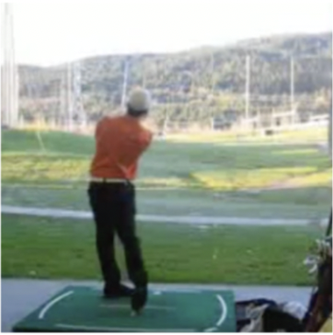
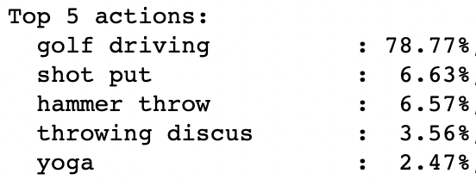
Video Representation Analysis Objectives
Action Classifcation
What information stored in internal representations of video models
Importance of motion / appearance
Supervised vs. unsupervised
CNN vs. Transformer
Importance of dataset / training objective

Slide 3
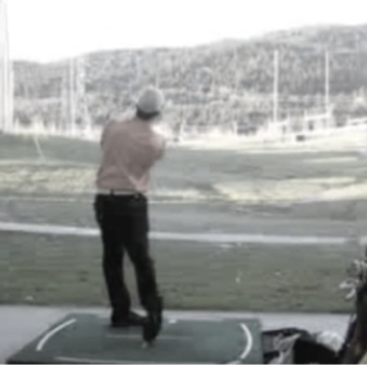
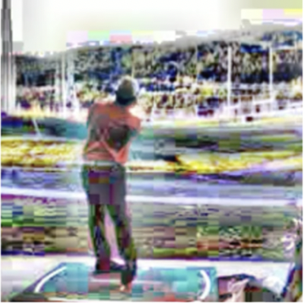
Video Representation Analysis Findings (so far)
I3D: Sensitivity towards appearance augmentations (saturation, clahe, …)
Dataset analysis: single frame prediction with Resnet50 (Imagenet pretrained)
Top 1 | 66.8 % (-10.1 %)
Top 3 | 83.9 % (-7.1 %)
Top 5 | 88.9 % (-5.3 %)
Top 1 | 50.9 % (-26.0 %)
Top 3 | 69.8 % (-21.2 %)
Top 5 | 76.5 % (-17.7 %)
Dataset | Top 1 Accuracy (comparison I3D)
HMDB51 | 49.9 % (+0.1 %)
UCF101 | 81.7 % (-2.8 %)
Kinetics400 | 49.1 % (-22.1 %)

Slide 4
Video Representation Analysis Next Steps
Use video representation of pretrained model for different readout tasks (freeze backbone model & train small network on top)
Discussion:
Further ideas for readout tasks
Experiment for temporal understanding: permutation of junks → prediction of permuation order (classification task)
Object Detection
Tracking
Segmentation
Temporal Understanding
…

